Slide 1
Chapter 15:
Recursion

Slide 2
Objectives
In this chapter, you will:
  Learn about recursive definitions
  Explore the base case and the general case of a recursive definition
  Discover what is a recursive algorithm
  Learn about recursive functions
  Use recursive functions to implement recursive algorithms
C++ Programming: From Problem Analysis to Program Design, Sixth Edition

Slide 3
Recursive Definitions
Recursion: solving a problem by reducing it to smaller versions of itself
  Provides a powerful way to solve certain problems which would be complicated otherwise
C++ Programming: From Problem Analysis to Program Design, Sixth Edition
Notes:
imperative languages use a counter variable, but such variables do not exist in pure functional languages. Rather than iteration to control repetition, functional languages use recursion
A functional language, such as LISP, is one in which computations are made primarily by applying functions to given parameters. In contrast, in imperative languages such as C, C++, and Java, computations are usually specified with variables and assignment statements. Functional languages offer potentially the greatest overall simplicity, because they can accomplish everything with a single construct, the function call, which can be combined simply with other function calls. This simple elegance is the reason why some language researchers are attracted to functional languages as the primary alternative to complex nonfunctional languages such as C++. Other factors, such as efficiency, however, have prevented functional languages from becoming more widely used.

Slide 4
Recursive Definitions (cont’d.)
Recursive definition: defining a problem in terms of a smaller version of itself
Base case: the case for which the solution is obtained directly
  Every recursive definition must have one (or more) base case(s)
  The base case stops the recursion
  General case: must eventually reduce to a base case
C++ Programming: From Problem Analysis to Program Design, Sixth Edition

Slide 5
Recursive Definitions (cont’d.)
Example: factorials
0! = 1 (1)
n! = n x (n-1)! if n > 0 (2)
  Equation (1) is called the base case
  Equation (2) is called the general case
C++ Programming: From Problem Analysis to Program Design, Sixth Edition
Notes:
Let us apply this definition to find 3!. Here, n = 3. Because n > 0, we use Equation 17-2 to obtain: 3! = 3*2! Next, we find 2! Here, n = 2. Because n > 0, we use Equation 17-2 to obtain: 2! = 2*1! Now, to find 1!, we again use Equation 17-2 because n = 1 > 0. Thus: 1! = 1*0! Finally, we use Equation 17-1 to find 0!, which is 1. Substituting 0! into 1! gives 1! = 1. This gives 2! = 2 _x0004_ 1! =2_x0004_ 1 = 2, which, in turn, gives 3! = 3 _x0004_ 2! = 3 _x0004_ 2 = 6.

Slide 6
Recursive Definitions (cont'd.)
Recursive algorithm: finds a solution by reducing problem to smaller versions of itself
  Must have one (or more) base cases
  General solution must eventually reduce to a base case
Recursive function: a function that calls itself
Recursive algorithms are implemented using recursive functions
C++ Programming: From Problem Analysis to Program Design, Sixth Edition
Notes:
From the previous example (factorial), it is clear that:
Every recursive definition must have one (or more) base cases.
The general case must eventually be reduced to a base case.
The base case stops the recursion.
The concept of recursion in computer science works similarly. Here, we talk about recursive algorithms and recursive functions.

Slide 7
Recursive Definitions (cont’d.)
Think of a recursive function as having infinitely many copies of itself
  Every call has its own code and its own set of parameters and local variables
  After completing a particular recursive call:
    Control goes back to the calling environment, the previous call
    Execution begins from the point immediately following the recursive call
C++ Programming: From Problem Analysis to Program Design, Sixth Edition

Slide 8
Direct and Indirect Recursion
Directly recursive: a function that calls itself
Indirectly recursive: a function that calls another function and eventually results in the original function call
Tail recursive function: recursive function in whose last statement executed is the recursive call
C++ Programming: From Problem Analysis to Program Design, Sixth Edition

Slide 9
Infinite Recursion
Infinite recursion: every recursive call results in another recursive call
  In theory, infinite recursion executes forever
Because computer memory is finite:
  Function executes until the system runs out of memory
  Results in an abnormal program termination
C++ Programming: From Problem Analysis to Program Design, Sixth Edition

Slide 10
Infinite Recursion (cont’d.)
To design a recursive function:
  Understand problem requirements
  Determine limiting conditions
  Identify base cases and provide a direct solution to each base case
  Identify general cases and provide a solution to each general case in terms of smaller versions of itself
C++ Programming: From Problem Analysis to Program Design, Sixth Edition

Slide 11
Infinite Recursion (cont’d.)
To design a recursive function:
  Understand problem requirements
    Find the Largent element in the array
  Determine limiting conditions
    For example, for a list, the limiting condition is the number of elements in the list.
  Identify base cases and provide a direct solution to each base case
    The size of the list is 1
C++ Programming: From Problem Analysis to Program Design, Sixth Edition

Slide 12
Infinite Recursion (cont’d.)
To design a recursive function: General Case:
    The size of the list is greater than 1
    To find the largest element in list[a]...list[b]
    a. Find the largest element in list[a + 1]...list[b] and call it max
    b. Compare the elements list[a] and max
      if (list[a] >= max)
        the largest element in list[a]...list[b] is list[a]
      Otherwise
        the largest element in list[a]...list[b] is max
C++ Programming: From Problem Analysis to Program Design, Sixth Edition

Slide 13
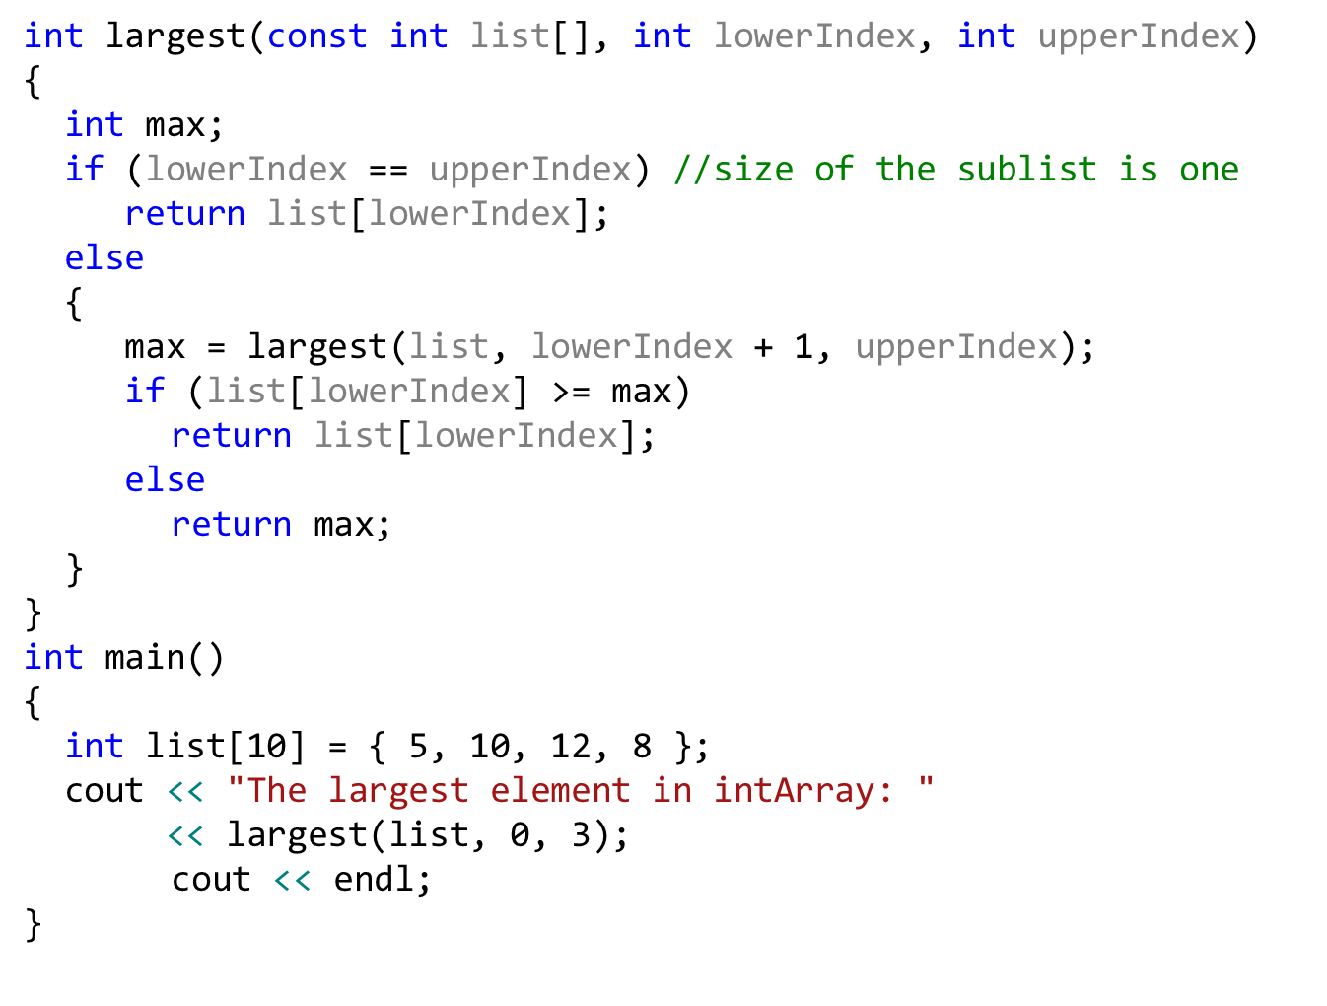
Infinite Recursion (cont’d.)
C++ Programming: From Problem Analysis to Program Design, Sixth Edition

Slide 14
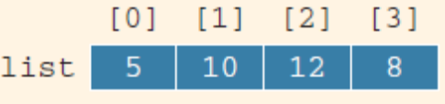
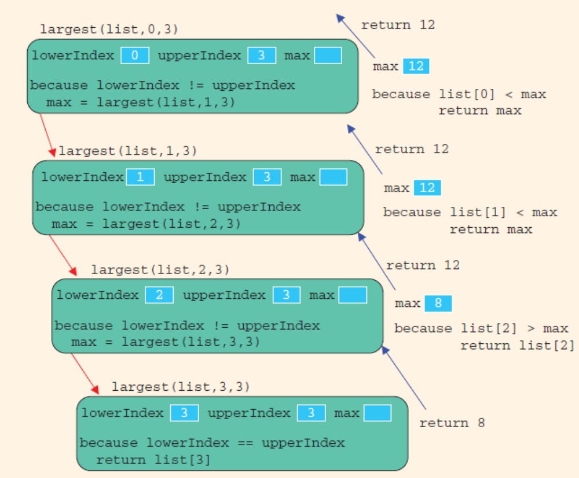
Infinite Recursion (cont’d.)
cout << largest(list, 0, 3) << endl;
C++ Programming: From Problem Analysis to Program Design, Sixth Edition

Slide 15
Recursion or Iteration?
Iterative control structure: uses a loop to repeat a set of statements
There are usually two ways to solve a particular problem:
  Iteration (looping)
  Recursion
When choosing, must consider:
  Nature of the problem
  Efficiency
C++ Programming: From Problem Analysis to Program Design, Sixth Edition

Slide 16
Recursion or Iteration? (cont’d.)
Whenever a function is called
  Memory space for its formal parameters and (automatic) local variables is allocated
When the function terminates
  That memory space is then deallocated
Every (recursive) call has its own set of parameters and (automatic) local variables
C++ Programming: From Problem Analysis to Program Design, Sixth Edition

Slide 17
Recursion or Iteration? (cont’d.)
Overhead associated with executing a (recursive) function in terms of:
  Memory space
  Computer time
A recursive function executes more slowly than its iterative counterpart
Today’s computers are fast
  Overhead of a recursion function is not noticeable
C++ Programming: From Problem Analysis to Program Design, Sixth Edition

Slide 18
Recursion or Iteration? (cont’d.)
Sometimes iterative solution is more obvious and easier to understand
If the definition of a problem is inherently recursive, consider a recursive solution
C++ Programming: From Problem Analysis to Program Design, Sixth Edition

Slide 19
Summary
Recursion: process of solving a problem by reducing it to smaller versions of itself
Recursive definition: defines a problem in terms of smaller versions of itself
  Has one or more base cases
Recursive algorithm: solves a problem by reducing it to smaller versions of itself
  Has one or more base cases
C++ Programming: From Problem Analysis to Program Design, Sixth Edition

Slide 20
Summary (cont’d.)
The solution to the problem in a base case is obtained directly
Recursive function: function that calls itself
  Must have one or more base cases
Recursive algorithms are implemented using recursive functions
The general solution breaks the problem into smaller versions of itself
C++ Programming: From Problem Analysis to Program Design, Sixth Edition

Slide 21
Summary (cont’d.)
The general case must eventually be reduced to a base case
  The base case stops the recursion
Directly recursive: a function calls itself
Indirectly recursive: a function calls another function and eventually calls the original
Tail recursive: the last statement executed is the recursive call
C++ Programming: From Problem Analysis to Program Design, Sixth Edition

